Slide 1
Examples of Primitive Values
Integer types
0 -1 365 12000
Floating-point types
0.99 -22.8 3.14159 5.0
Character type
'a' 'A' '#' ' '
Boolean type
true false

Slide 2
Assignment Statements
An assignment statement is used to assign a value to a variable.
answer = 42;
The "equal sign" is called the assignment operator.
We say, "The variable named answer is assigned a value of 42," or more simply, "answer is assigned 42."

Slide 3
Assignment Examples
amount = 3.99;
firstInitial = 'W';
birthYear = currentYear - age;
total = total + 2;

Slide 4
Assignment Compatibilities
Java is said to be strongly typed.
You can't, for example, assign a floating point value to a variable declared to store an integer.
Sometimes conversions between numbers are possible.
doubleVariable = 7;
is possible even if doubleVariable is of type double, for example.

Slide 5
Arithmetic Operators
Arithmetic expressions can be formed using the +, -, *, and / operators together with variables or numbers referred to as operands.
When both operands are of the same type, the result is of that type.
When one of the operands is a floating-point type and the other is an integer, the result is a floating point type.

Slide 6
Arithmetic Operators
Example
If hoursWorked is an int to which the value 40 has been assigned, and payRate is a double to which 8.25 has been assigned
hoursWorked * payRate
is a double with a value of 500.0.

Slide 7
The Division Operator
The division operator (/) behaves as expected if one of the operands is a floating-point type.
When both operands are integer types, the result is truncated, not rounded.
Hence, 99/100 has a value of 0.

Slide 8
The mod Operator
The mod (%) operator is used with operators of integer type to obtain the remainder after integer division.
14 divided by 4 is 3 with a remainder of 2.
Hence, 14 % 4 is equal to 2.
The mod operator has many uses, including
determining if an integer is odd or even
determining if one integer is evenly divisible by another integer.

Slide 9
Sample Expressions

Slide 10
The Class String
We've used constants of type String already.
"Enter a whole number from 1 to 99."
A value of type String is a
Sequence of characters
Treated as a single item.

Slide 11
Concatenation of Strings
Two strings are concatenated using the + operator.
String greeting = "Hello";
String sentence;
sentence = greeting + " madam";
System.out.println(sentence);
Any number of strings can be concatenated using the + operator.

Slide 12
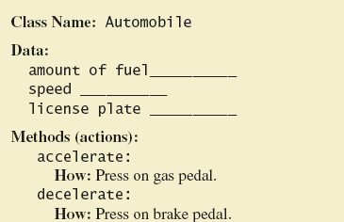
Class and Method Definitions

Slide 13
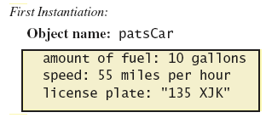
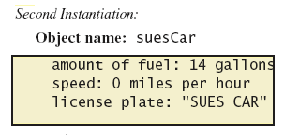
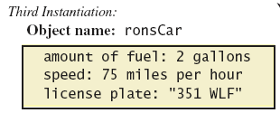
Class and Method Definitions
Objects that are instantiations of the class Automobile

Slide 14
Methods
When you use a method you "invoke" or "call" it
Two kinds of Java methods
Return a single item
Perform some other action – a void method
The method main is a void method
Invoked by the system
Not by the application program

