Slide 1
Loops
A portion of a program that repeats a statement or a group of statements is called a loop.
The statement or group of statements to be repeated is called the body of the loop.
A loop could be used to compute grades for each student in a class.
There must be a means of exiting the loop.

Slide 2
The while Statement
Also called a while loop
A while statement repeats while a controlling boolean expression remains true
The loop body typically contains an action that ultimately causes the controlling boolean expression to become false.

Slide 3
The while Statement
Syntax
while (Boolean_Expression)
Body_Statement
or
while (Boolean_Expression)
{
First_Statement
Second_Statement
…
}

Slide 4
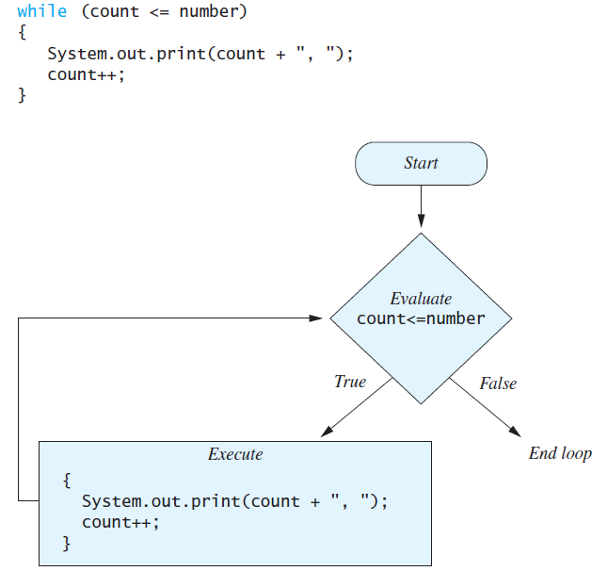
The while Statement

Slide 5
The do-while statement
Also called a do-while loop
Similar to a while statement, except that the loop body is executed at least once
Syntax
do
Body_Statement
while (Boolean_Expression);
Don’t forget the semicolon!

Slide 6
The for Statement
A for statement executes the body of a loop a fixed number of times.
Example
for (count = 1; count <= 10; count++)
System.out.println(count);

Slide 7
The for Statement
Syntax
for (Initialization, Condition, Update)
Body_Statement
Body_Statement can be either a simple statement or a compound statement in {}.
Corresponding while statement
Initialization
while (Condition)
Body_Statement_Including_Update

Slide 8
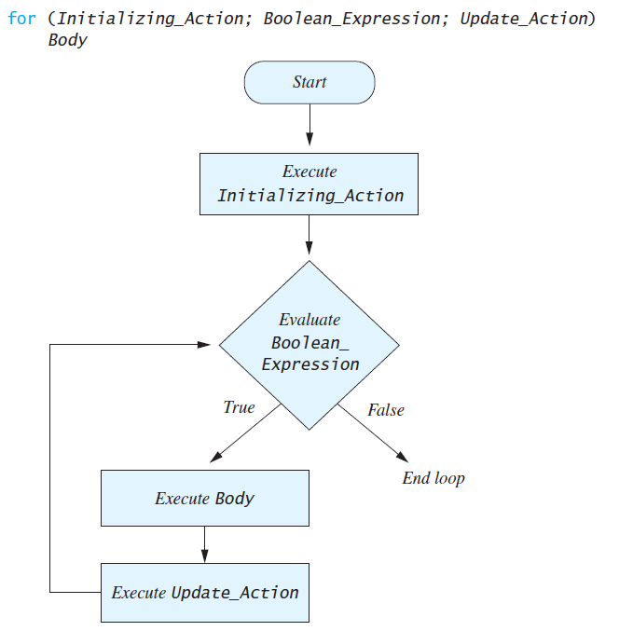
The for Statement

Slide 9
Matching Game
Algorithm
Ask the user to play the game or quit
If the user decides to play
Generate 3 random numbers
If all 3 numbers match, display the message “You Win!”
If any two numbers match, display the message “Matched 2”
Otherwise, display the message “Sorry. Better luck next time”
Repeat until the user quits

